Slide 1
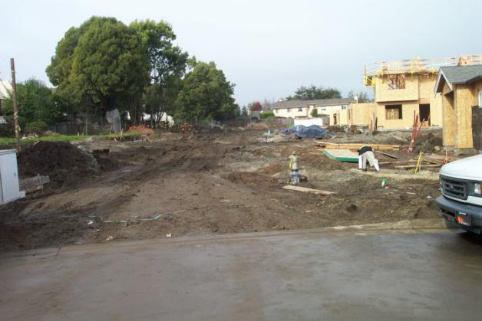
Stormwater Pollution Control Training (AKA Wet Weather 101) September 2015
Kent Edler, Senior Civil Engineer
County of Santa Cruz Planning Department

Slide 2
Stormwater Pollution / Erosion and Sediment Control Overview
What is stormwater pollution control?
Why it’s important
Examples concepts to stay in compliance

Slide 3
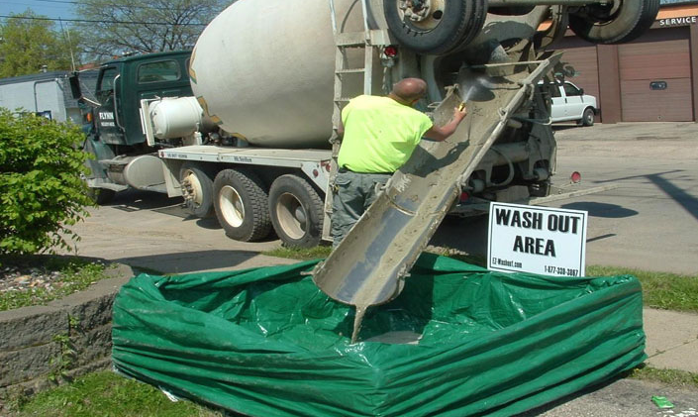
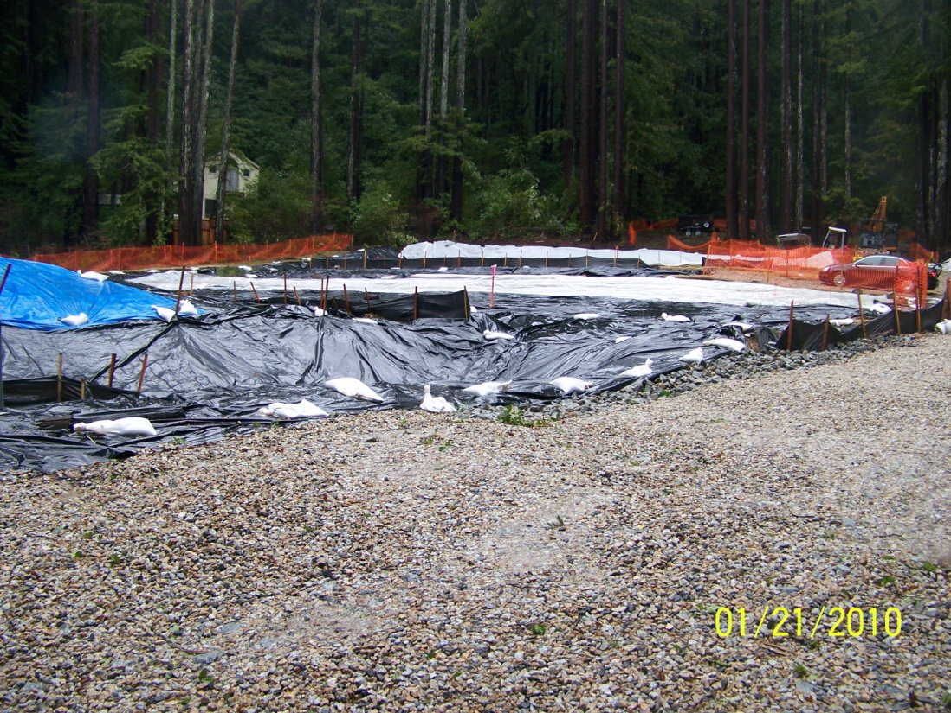
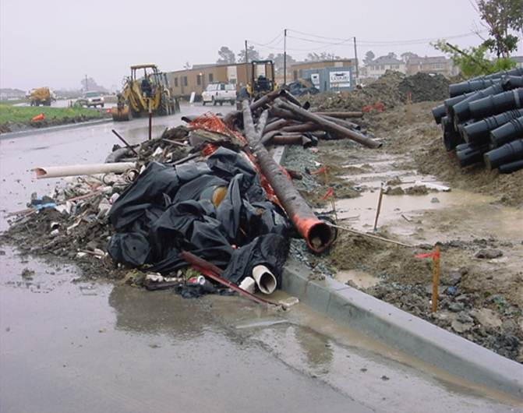
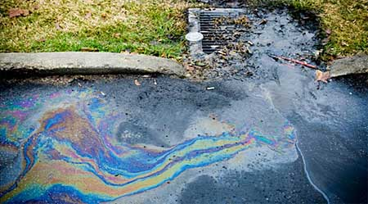
What is Stormwater Pollution Control?

Slide 4
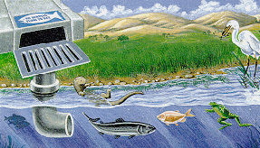
What is it Important?

Slide 5
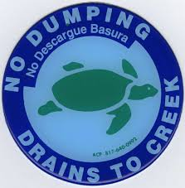
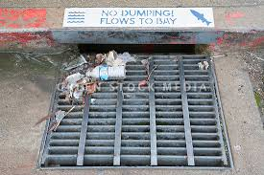
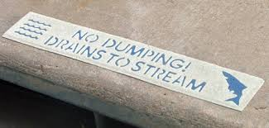
What is it Important?

Slide 6
Why it’s Important

Slide 7
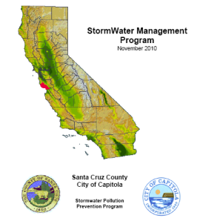
City and County Storm Water Programs

Slide 8
Examples of Implementation Programs
Brochures
Website
Community Events
Dog Waste
Watershed and Creek Signage
Riparian Restoration and Protection
Green Building
Education Programs for Children
Storm Drain Stenciling
Beach Clean-ups
Storm Sewer Mapping
Facility Inspections
Stormwater Ordinance
Septic System Maintenance / Management Program
Evaluation of Ordinance and Policies
Construction Inspections

Slide 9
How to stay in Compliance…..

Slide 10
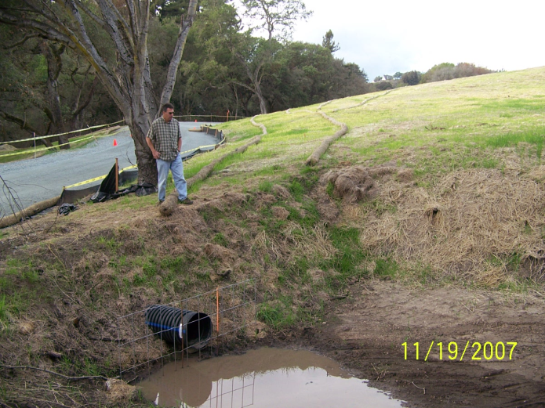
Erosion and Sediment Control
Sediment Control
?
Erosion Control
Drainage and Sediment Control

Slide 11
The Good, The Bad and the Ugly

Slide 12
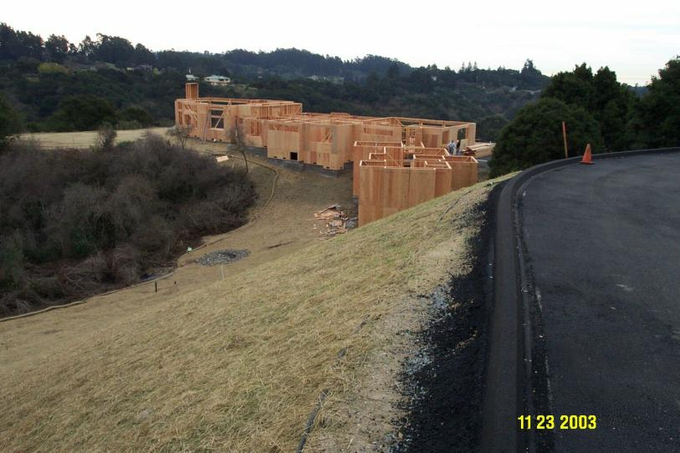
The Good

Slide 13
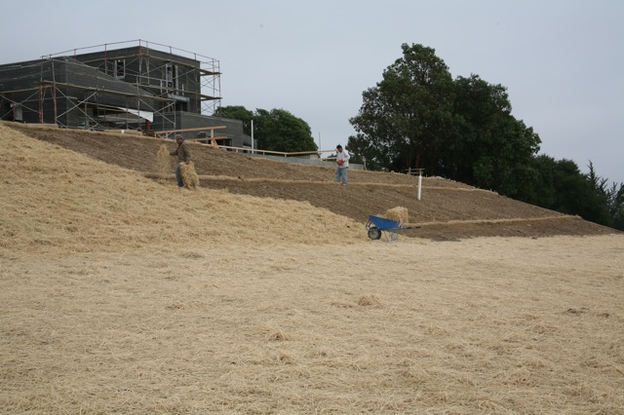
The Good

Slide 14
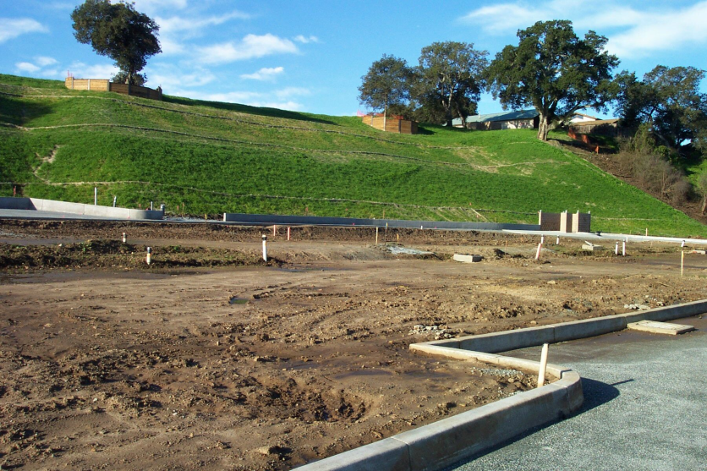
The Good

Slide 15
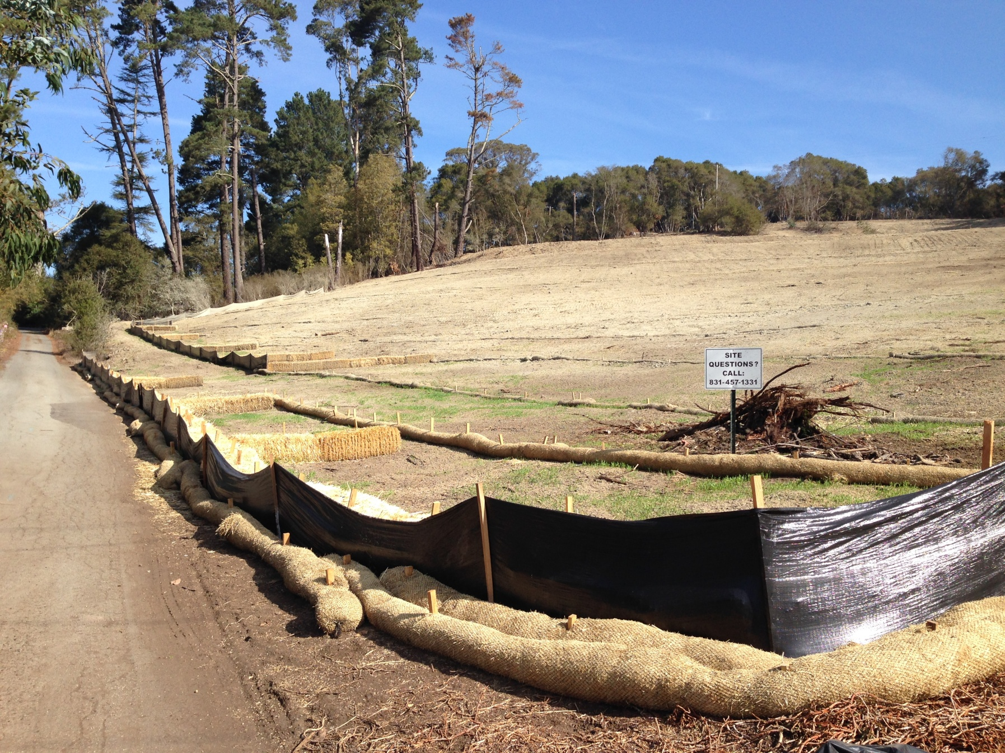
The Good

Slide 16
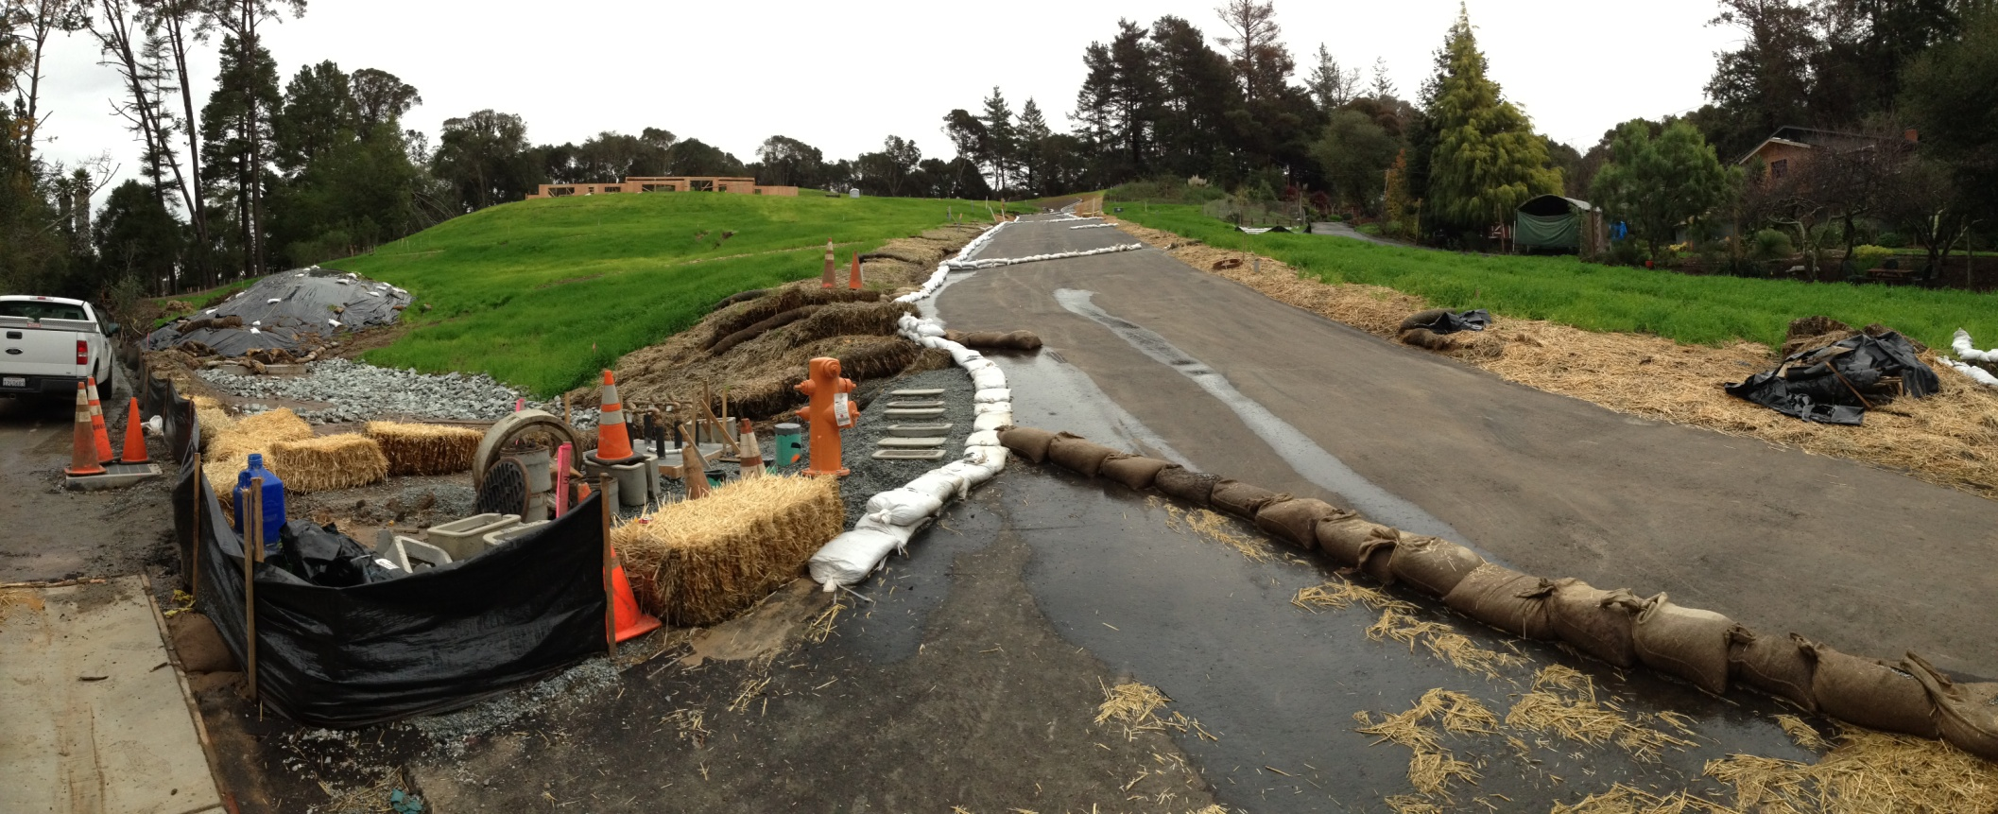
The Good
Covered Stockpile
Erosion Control
Sediment Basin / Sediment Control
Drainage Control

Slide 17
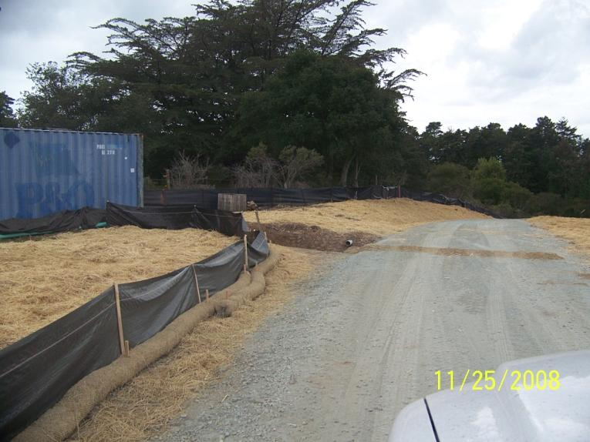
The Good

Slide 18
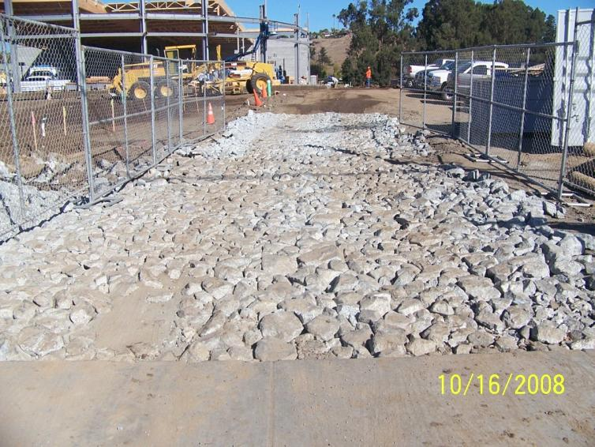
The Sorta Good

Slide 19
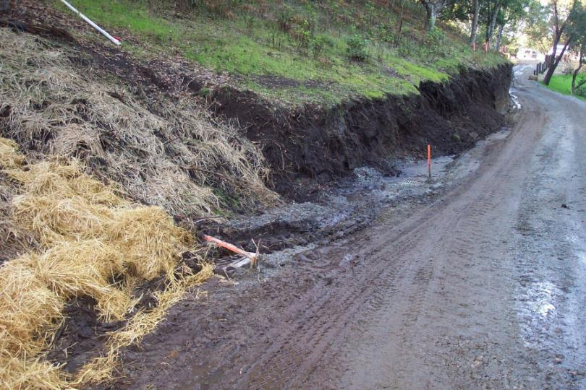
The Bad

Slide 20
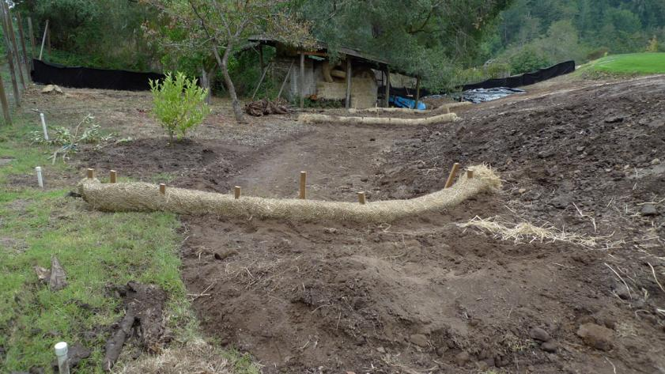
The Bad

Slide 21
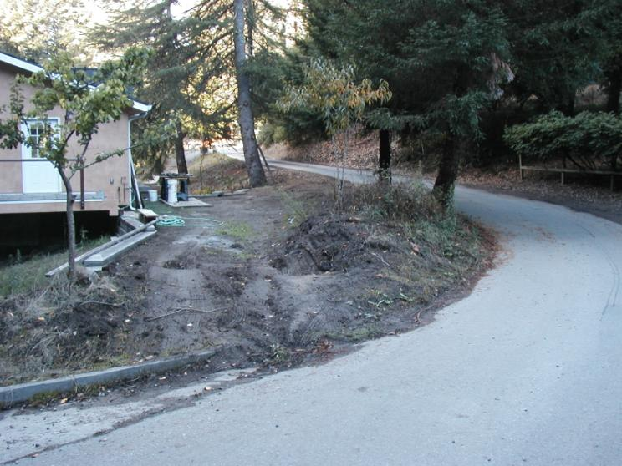
The Bad

Slide 22
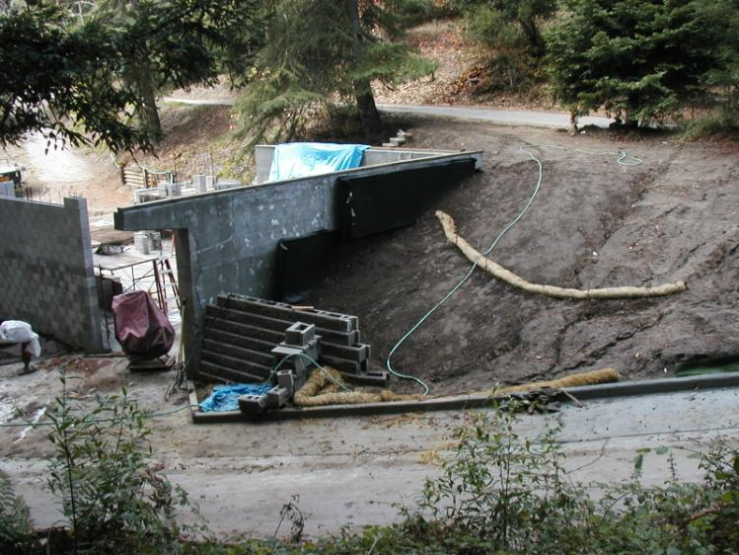
The Bad

Slide 23
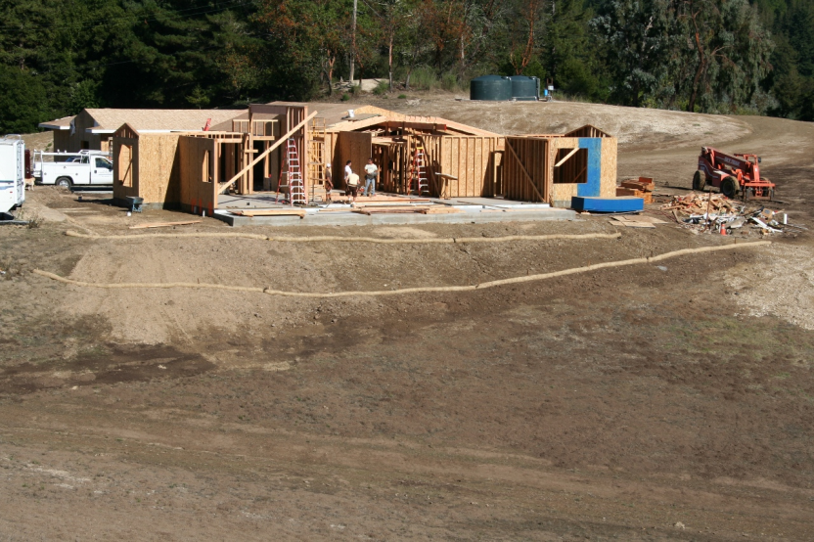
The Bad

Slide 24
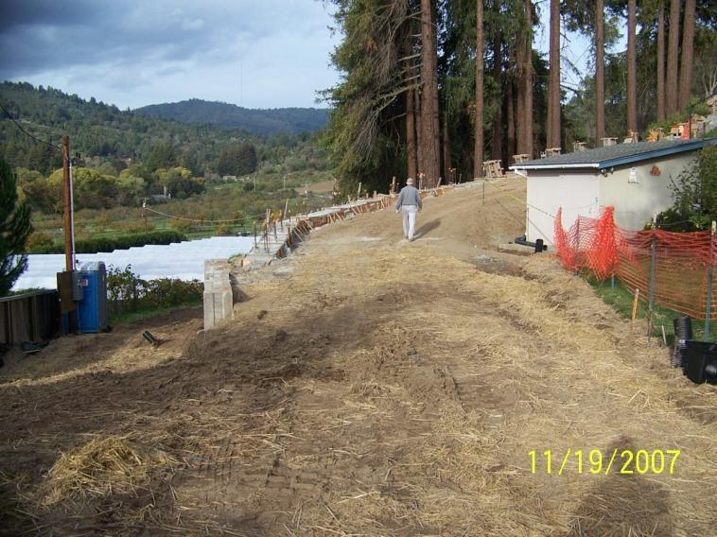
The Bad

Slide 25
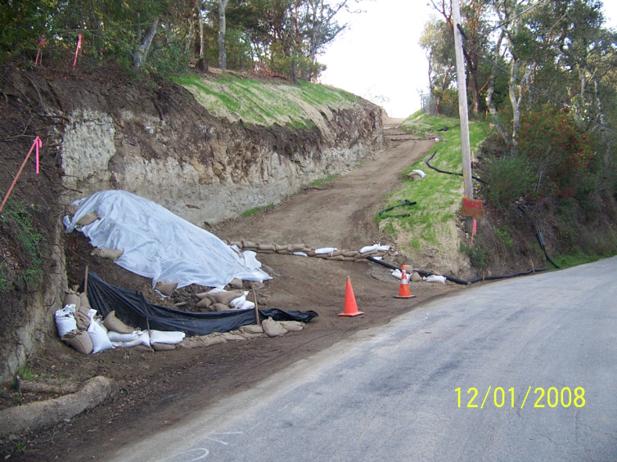
The Could be Better

Slide 26
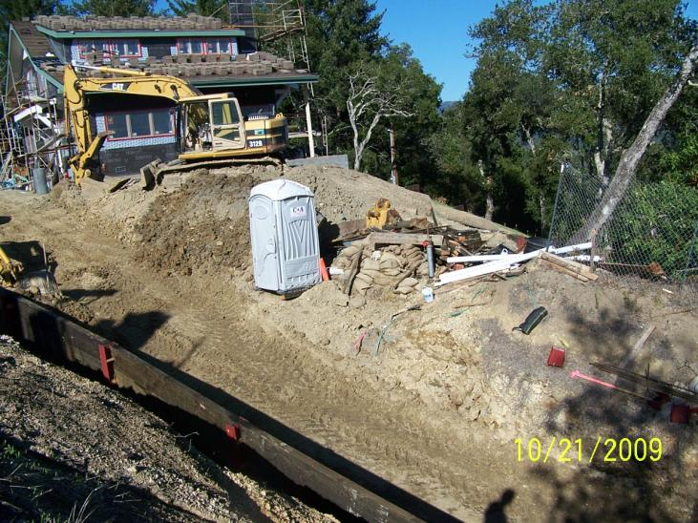
The Ugly

Slide 27
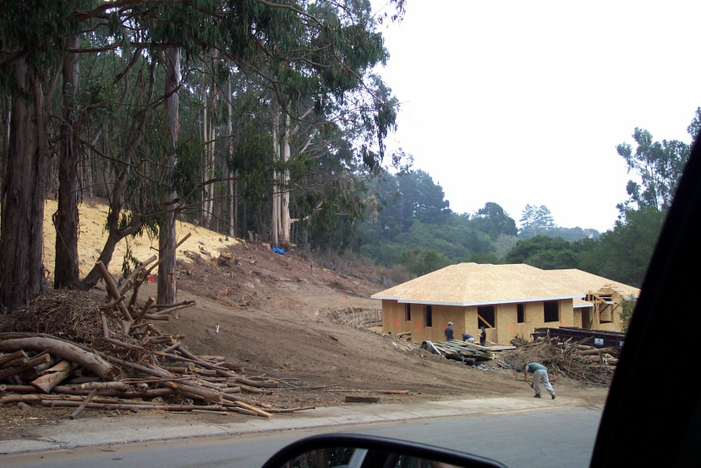
The Ugly

Slide 28
The Really, Really Ugly

Slide 29
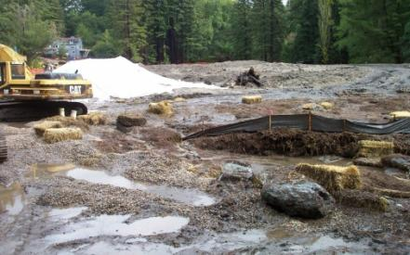
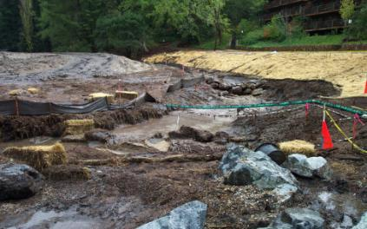
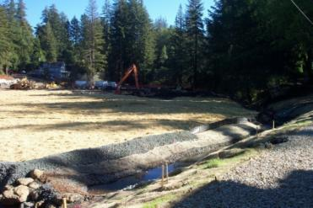
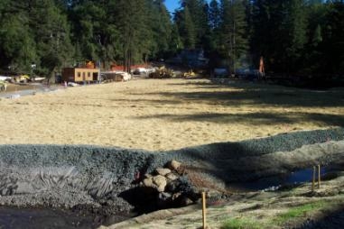
The Really, Really Ugly
10-19-2004
11-23-2004

Slide 30
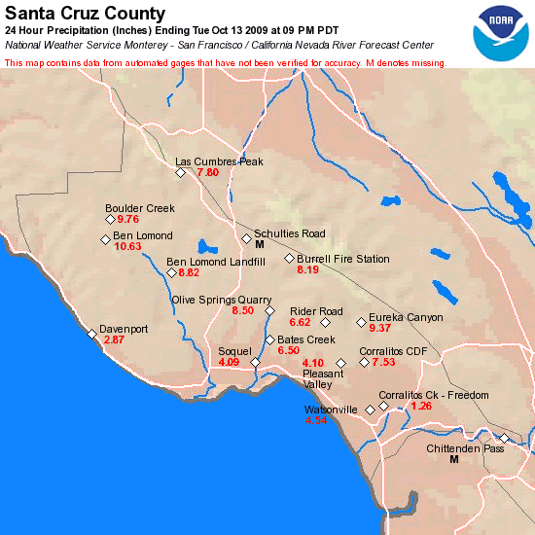
County Rainfall

Slide 31
Site House Keeping & Construction Waste Control

Slide 32
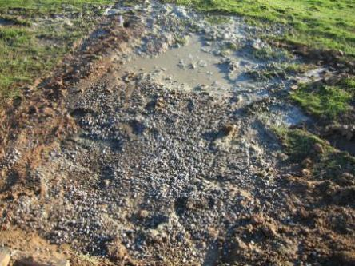
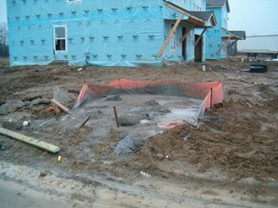
Concrete / Paint Washouts

Slide 33
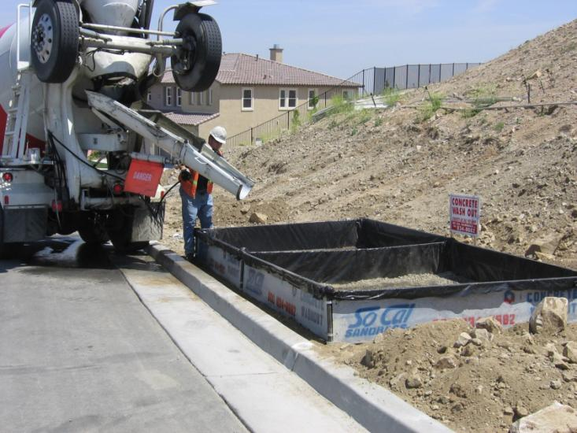
Concrete / Paint Washouts

Slide 34
Site House Keeping

Slide 35
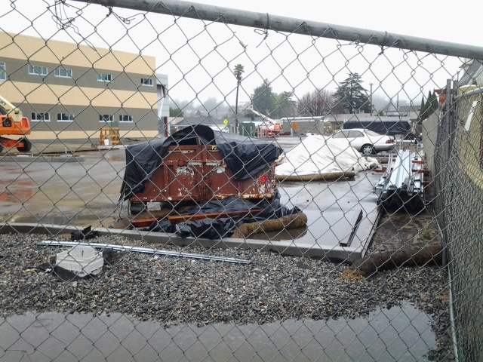
Site House Keeping

Slide 36
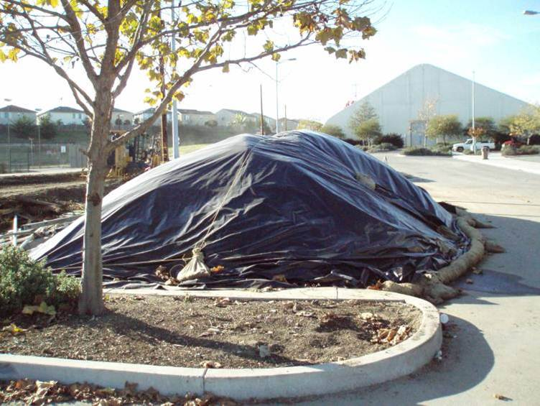
Site House Keeping

Slide 37
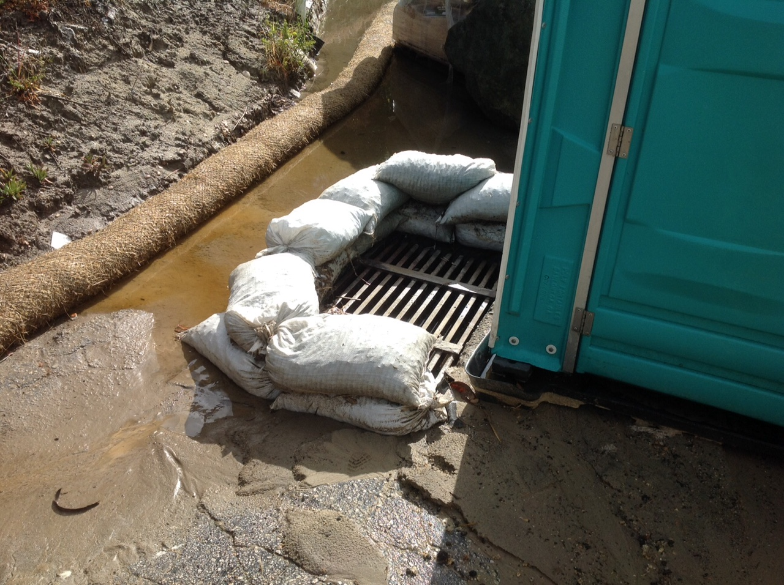
Site House Keeping

Slide 38
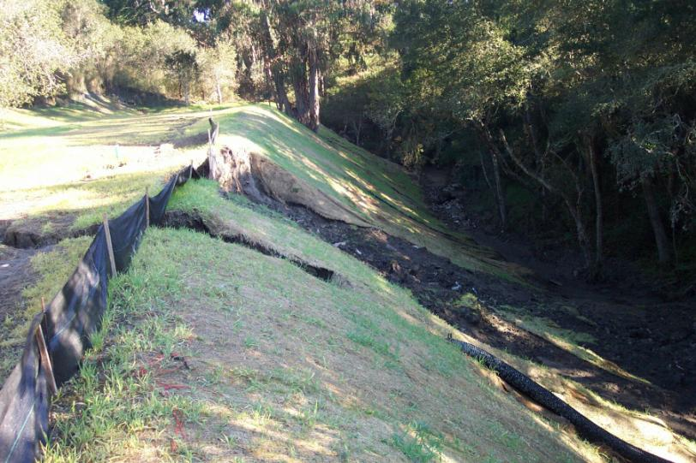
Erosion / Drainage Control & Geotechnical Issues

Slide 39
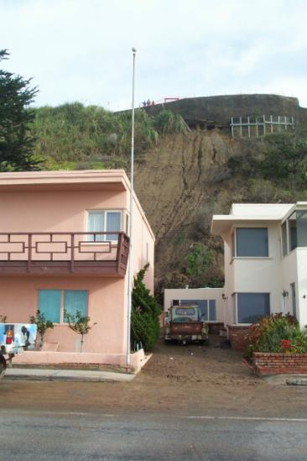
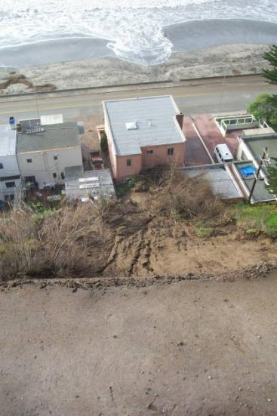
Erosion / Drainage Control & Geotechnical Issues

Slide 40
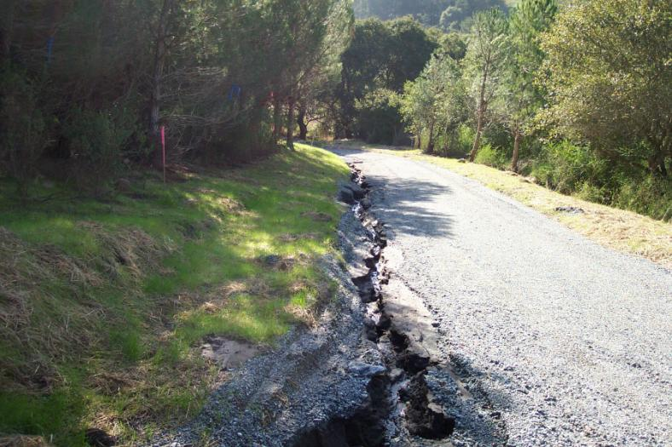
Erosion / Drainage Control & Geotechnical Issues

Slide 41
Tips & Recommendations for Wet Weather Preparedness
Keep extra material on site
Utilize the States “Rain Event Action Plan” (REAP) checklist
Train subs and crews
Check on your site when it’s raining

Slide 42
We’re Here to Help
City of Capitola
Brian VanSon - bvanson@ci.capitola.ca.us; 831-475-7300
Danielle Uharriet - duharriet@ci.capitola.ca.us; 831-475-7300
City of Santa Cruz
Agnes Topp – Atopp@cityofsantacruz.com; 831-420-5423
City of Scotts Valley
Kimarie Jones – kjones@scottsvalley.org; 831-438-5854
City of Watsonville
County of Santa Cruz
Kent Edler – Kent.Edler@santacruzcounty.us; 831-454-3168

Slide 43
Thank You for Attending!

